Slide 1
Digestive System Models

Slide 2
Digestive System Plaque

Slide 3
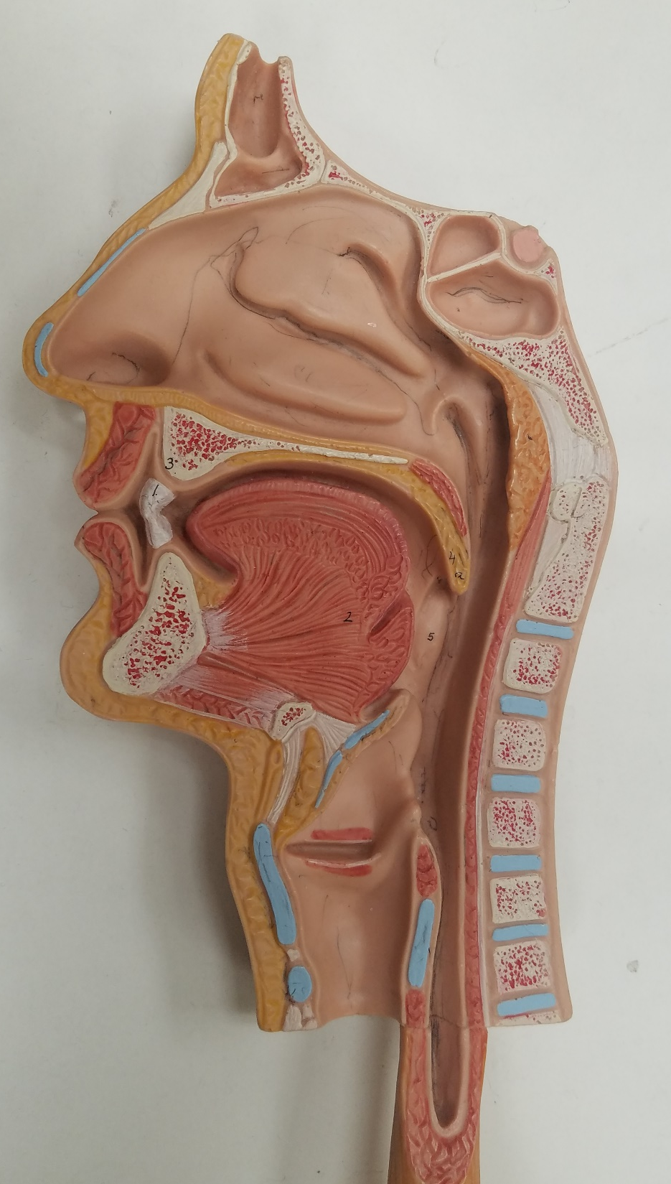
Digestive System Plaque – Superior View
Superior Nasal Concha(e)
Middle Nasal Concha(e)
Inferior Nasal Concha(e)

Slide 4
Digestive System Plaque – Superior View
Sphenoid or Sphenoidal Sinus
Frontal Sinus

Slide 5
Digestive System Plaque – Superior View
Teeth
Esophagus
Tongue

Slide 6
Digestive System Plaque – Superior View
Pharynx - Nasopharynx
Pharynx - Oropharynx
Pharynx - Laryngopharynx

Slide 7
Digestive System Plaque – Superior View
Hard Palate
Uvula

Slide 8
Digestive System Plaque – Superior View
Larynx - Epiglottis
Larynx –
Thyroid Cartilage
Larynx – Cricoid Cartilage

Slide 9
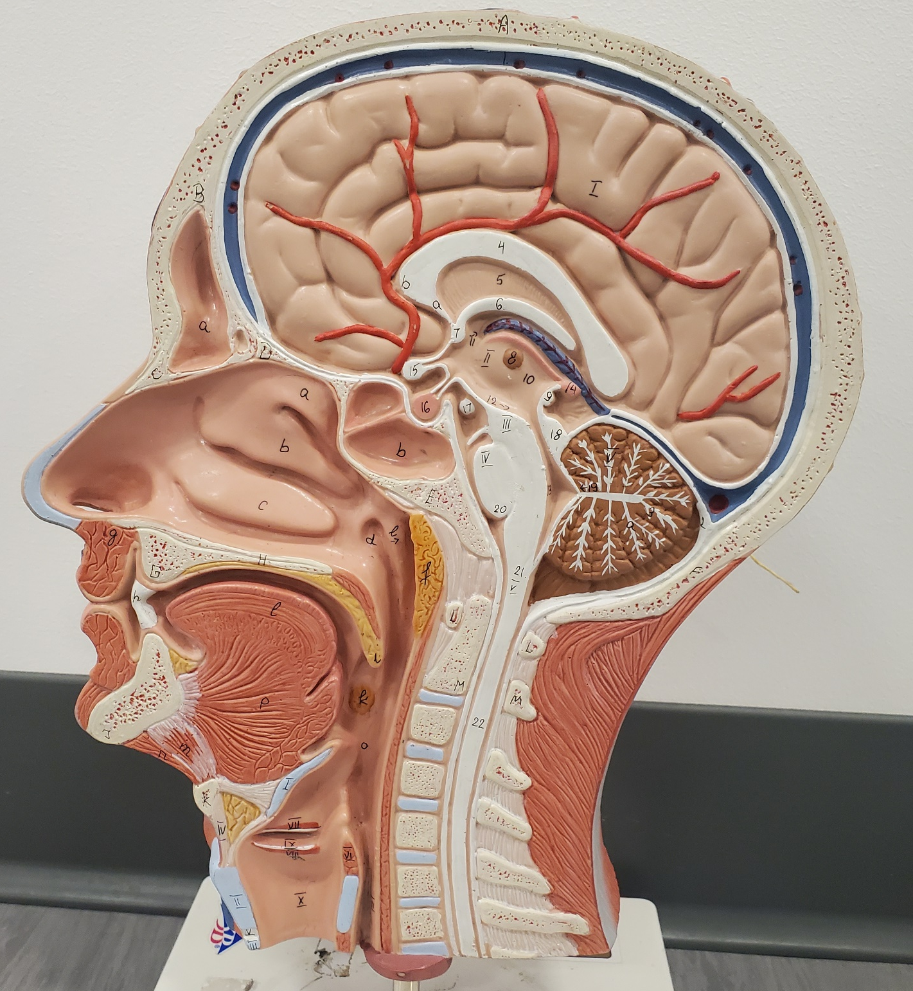
Sagittal Head
Do not forget to study all structures from the Anatomy of the Respiratory System
Teeth
Tongue

Slide 10
Sagittal Head
Do not forget to study all structures from the Anatomy of the Respiratory System
Hard Palate
Esophagus
Uvula

Slide 11
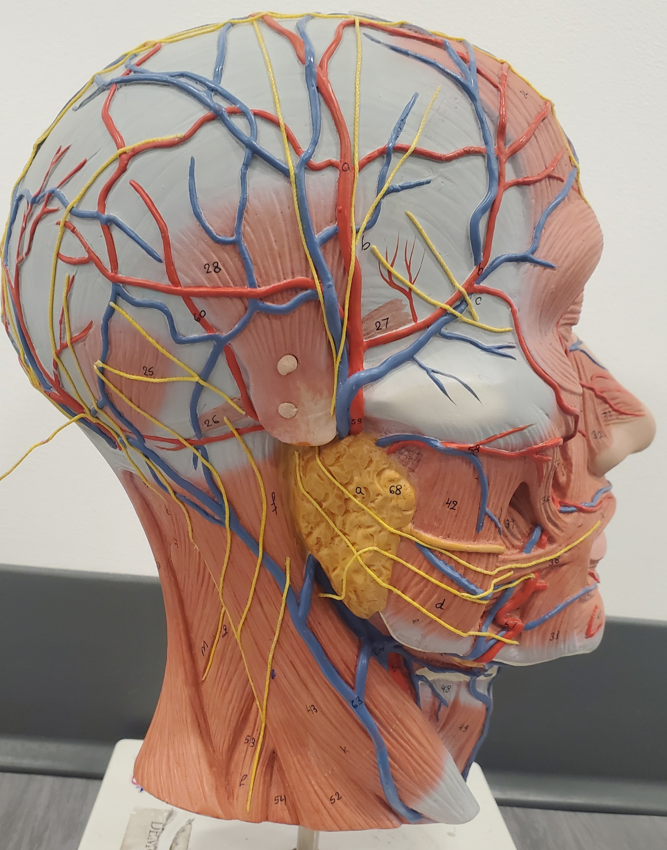
Sagittal Head SALIVARY GLANDS
Parotid Gland

Slide 12
Sagittal Head SALIVARY GLANDS
Sublingual Gland
Submandibular Gland

Slide 13
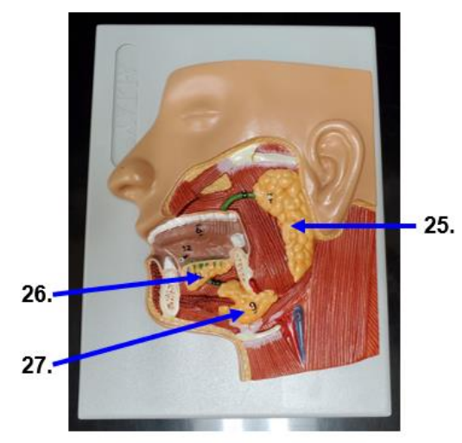
Can you name the salivary glands on this model?

Slide 14
Salivary Gland Model
Parotid Gland
Sublingual Gland
Submandibular Gland

Slide 15
Digestive System Plaque – Superior View
Esophagus
Stomach
Liver

Slide 16
4 Regions of the Stomach
Cardiac Region: region attached to esophagus
Fundus (Fundic region): most superior region
Body: Middle, biggest region
Pylorus (Pyloric region): narrow region connects to small intestine

Slide 17
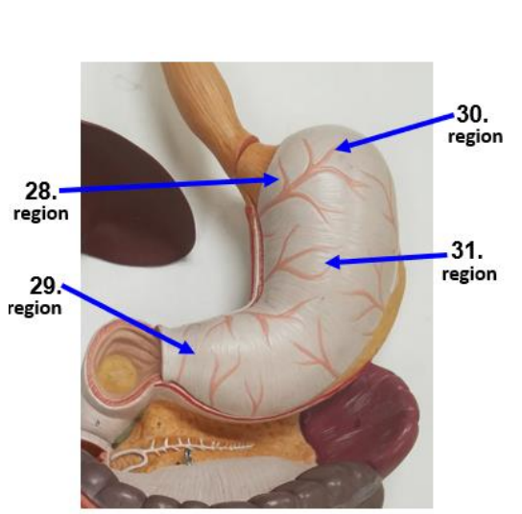
Name these stomach body regions

Slide 18
Digestive System Plaque – Superior View
Fundus or Fundic Region
Cardiac Region
Pylorus or Pyloric Region
Body Region

Slide 19
Digestive System Plaque – Superior View
Stomach – Greater Curvature
Stomach – Lesser Curvature

Slide 20
Sphincters!
Sphincter: ring of smooth muscle that controls opening and closing of an area

Slide 21
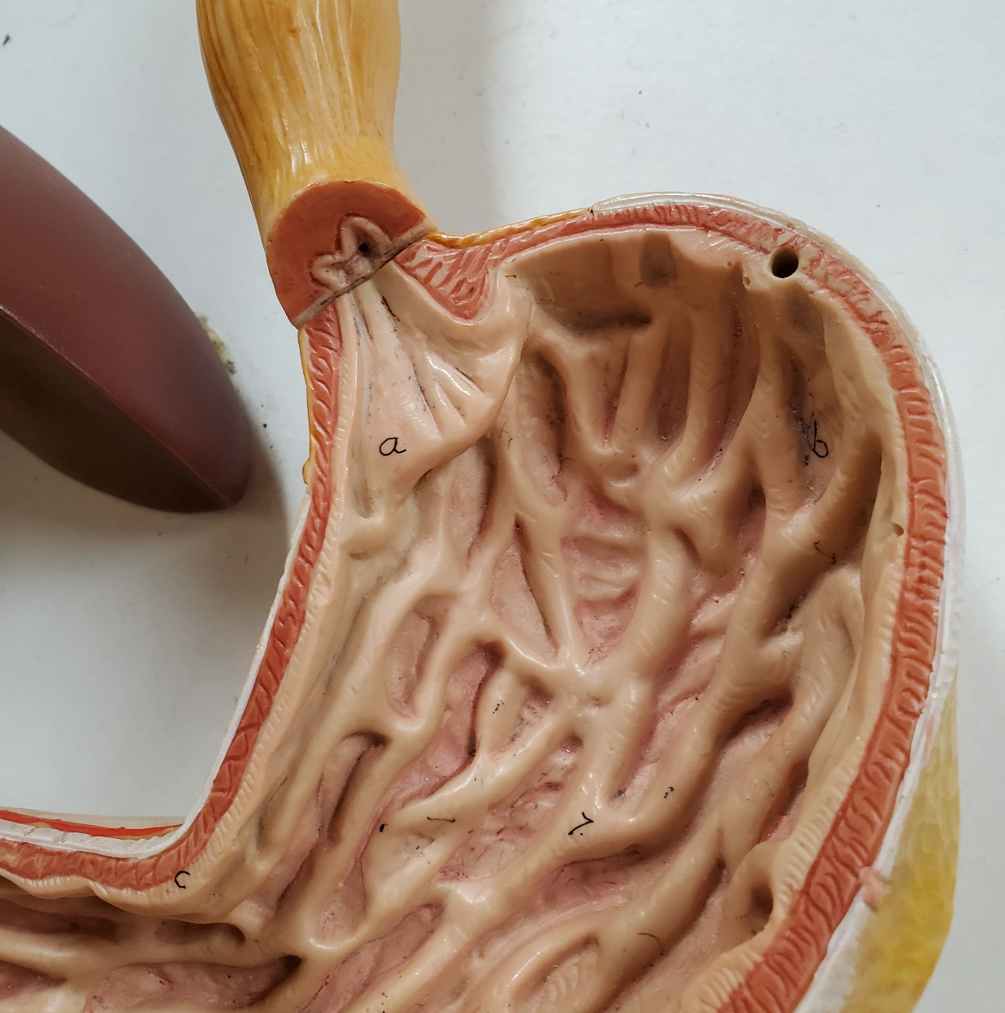
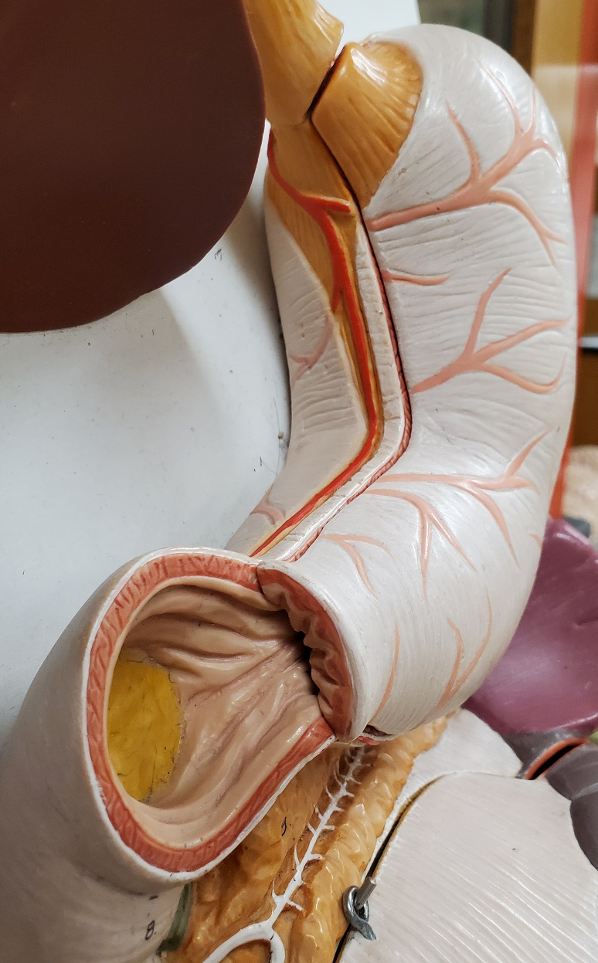
Internal Stomach
Cardiac (lower esophageal)
sphincter
Pyloric sphincter
Rugae

Slide 22
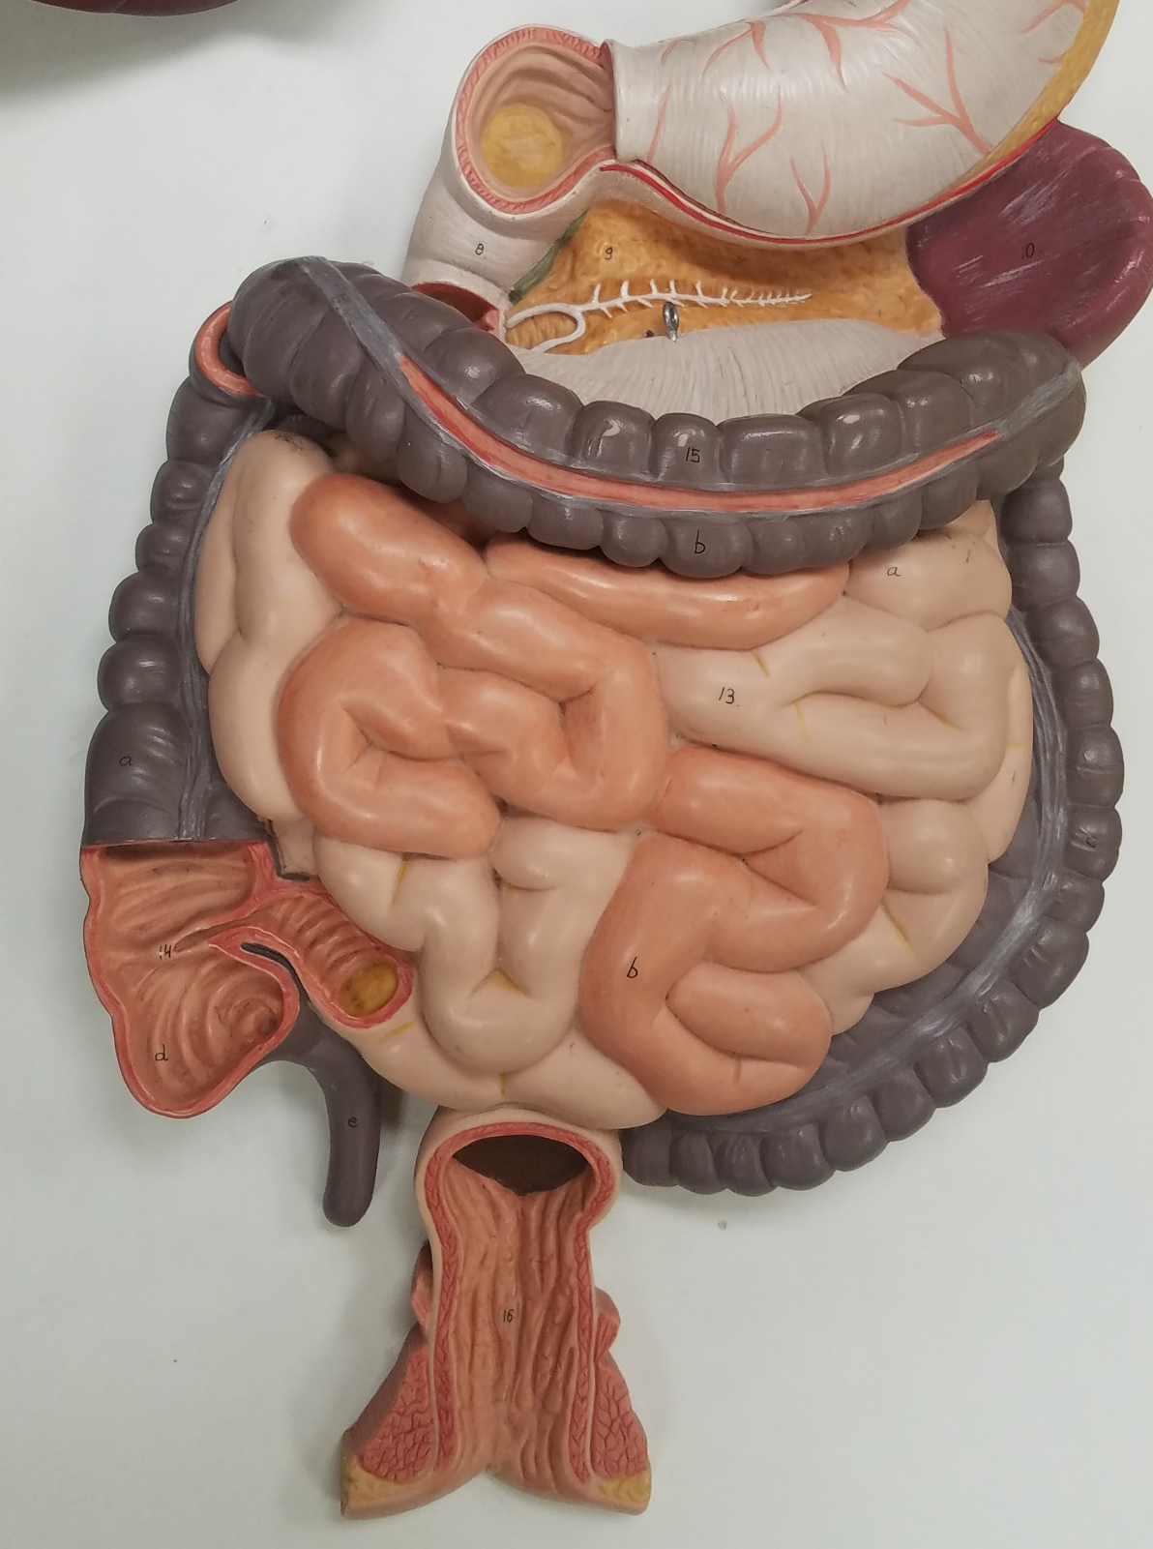
Digestive Plaque – Inferior View
Small Intestine
Duodenum
Jejunum (section in darker flesh color)
Ileum (section in lighter flesh color)
ileocecal valve

Slide 23
Digestive Plaque – Inferior View
Large Intestine
Cecum
Appendix

Slide 24
Digestive Plaque – Inferior View
Large Intestine
Transverse Colon
Ascending
Colon
Descending
Colon
Sigmoid
Colon

Slide 25
Digestive Plaque – Inferior View Large Intestine
Rectum
Anus (another hole!)

Slide 26
Digestive System Plaque – Liver
Falciform Ligament
Quadrate Lobe
Left Lobe
Right Lobe
Caudate Lobe

Slide 27
Digestive System Plaque
Esophagus
Gallbladder
Stomach
Spleen
Pancreas

Slide 28
Pancreas & Gall Bladder

Slide 29
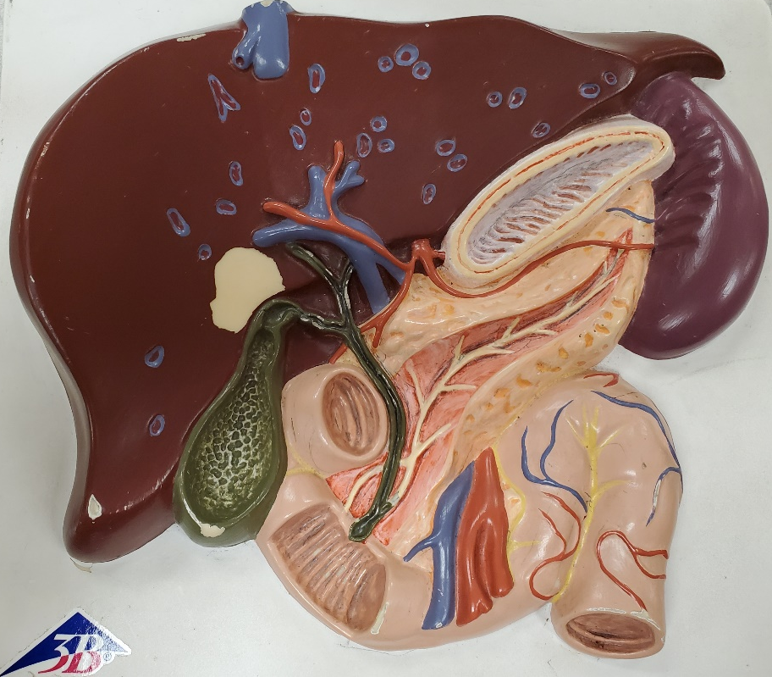
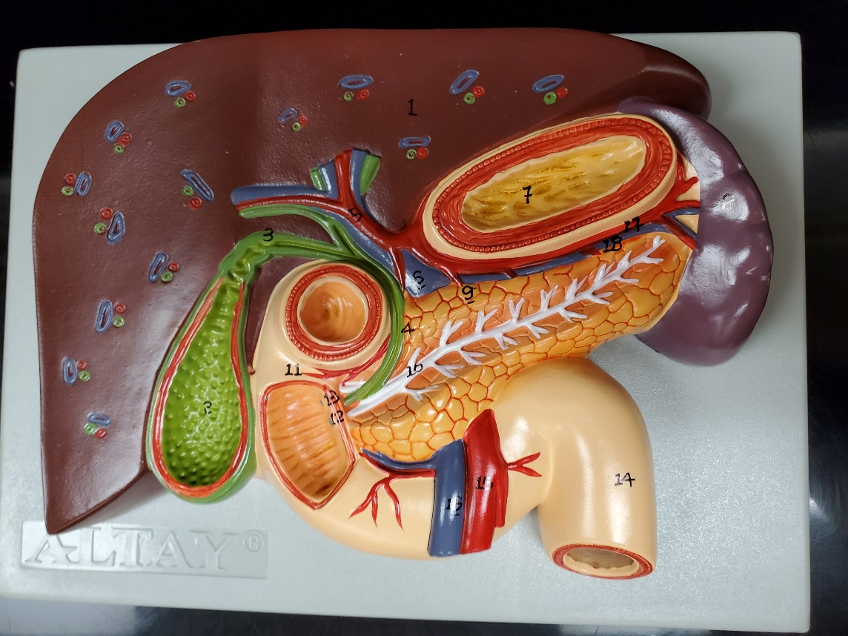
There are 2 different Liver Plaques. Consult your Lab Packet to see which structures to find on which Liver Plaque (# = 1 Liver Plaque #1, @ = Liver Plaque #2)
Liver Plaque #1
Liver Plaque #2

Slide 30
Liver Plaque #1
Liver
Stomach (cut)
Spleen
Pancreas
Gallbladder
Duodenum

Slide 31
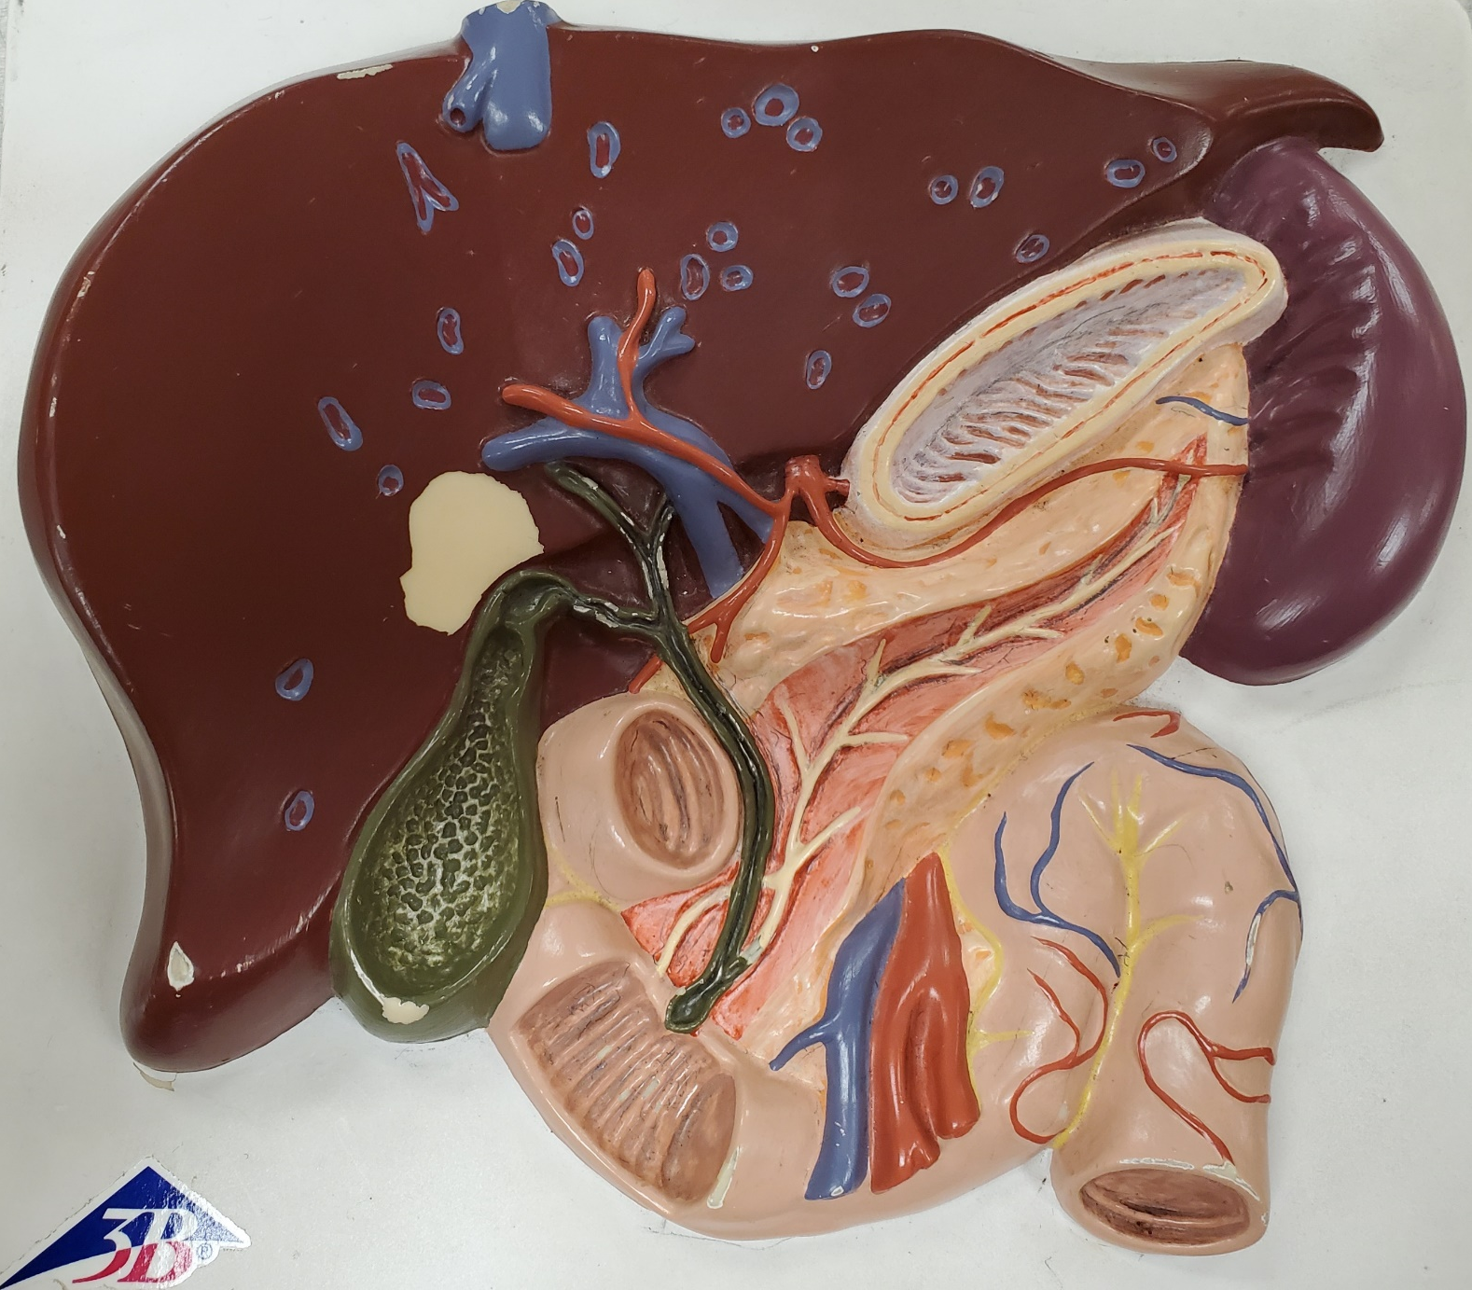
Liver Plaque #1
Left Hepatic Duct
Right Hepatic Duct
Common Hepatic Duct
Cystic Duct
Gallbladder
Common Bile Duct

Slide 32
Liver Plaque #1
Main Pancreatic Duct
Accessory Pancreatic Duct

Slide 33
Liver Plaque #1
Superior Mesenteric Artery
Superior Mesenteric Vein

Slide 34
Liver Plaque #1
Left Gastric Artery
Common Hepatic Artery
Splenic Artery
Celiac Trunk
Right Gastric Artery

Slide 35
Liver Plaque #2
Common Hepatic Artery
Celiac Trunk
Left Gastric Artery
(can’t see it!)
Splenic Artery
Right Gastric Artery
(hard to see)

Slide 36
Liver Plaque #1
Inferior Vena Cava
Hepatic Vein
Hepatic
Portal Vein

Slide 37
Spleen, Pancreas & Duodenum – Anterior View
Gabladder
Liver
Adrenal Gland
Kidney
Pancreas
Spleen
Duodenum

Slide 38
Spleen, Pancreas & Duodenum – Anterior View
Adrenal Gland
Kidney

Slide 39
Spleen, Pancreas & Duodenum – Anterior View
Right Hepatic Duct
Left Hepatic Duct
Common Hepatic Duct
Cystic Duct
Common Bile
Duct

Slide 40
Spleen, Pancreas & Duodenum – Anterior View
Head of Pancreas
Tail of Pancreas

Slide 41
Spleen, Pancreas & Duodenum – Anterior View
Accessory Pancreatic
Duct
Main Pancreatic
Duct

Slide 42
Spleen, Pancreas & Duodenum – Anterior View
Superior Mesenteric
Artery
Superior Mesenteric
Vein

Slide 43
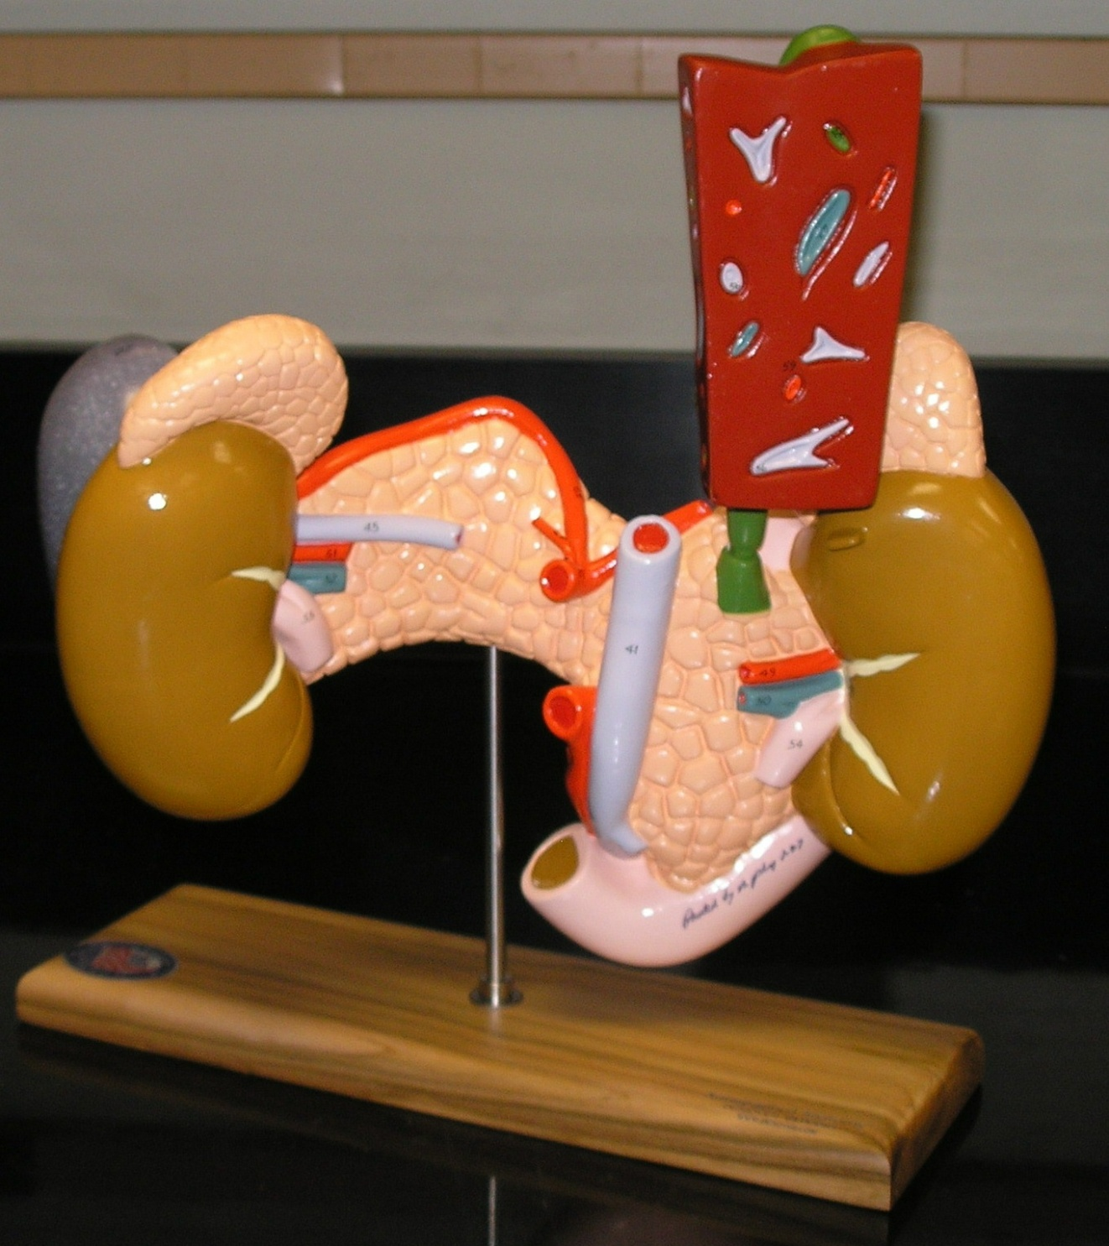
Pancreas/Duodenum/Spleen Posterior View
Liver
Spleen
Adrenal Gland
Kidney
Pancreas
Common Bile
Duct
Duodenum

Slide 44
Pancreas/Duodenum/Spleen Posterior View
Hepatic Vein
Splenic Vein
Hepatic Portal Vein

Slide 45
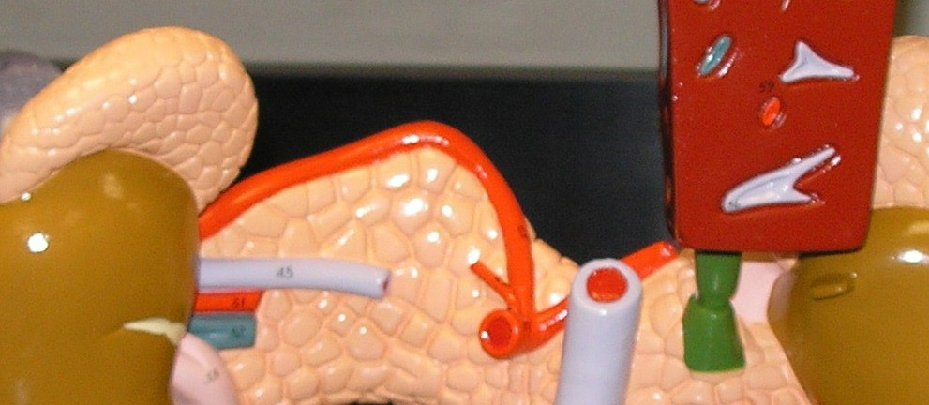
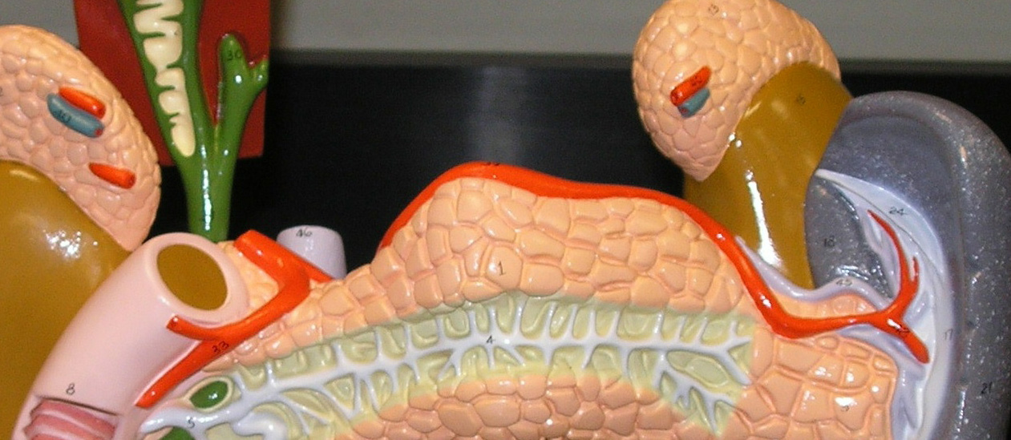
Pancreas/Duodenum/Spleen – Celiac Trunk
Common Hepatic Artery
Posterior View
Splenic Artery
Left Gastric Artery
Celiac Trunk
Anterior View
Splenic Artery
Common Hepatic Artery
Right Gastric Artery

Slide 46
Pancreas/Duodenum/Spleen – Posterior View
Left
Renal Artery
Right Renal Artery
Left
Renal Vein
Right
Renal Vein

