Slide 1
Spinal Cord Anatomy

Slide 2
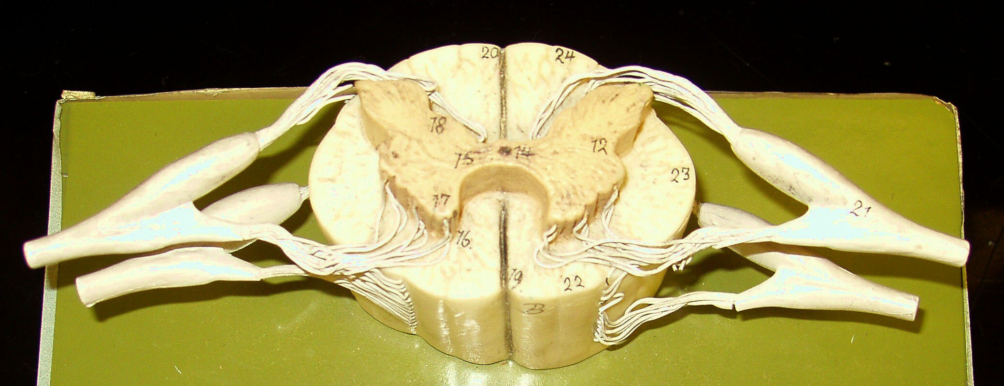
Remember: You can use Dorsal or Posterior
Dorsal Funiculus
Lateral Funiculus
Remember: You can use Ventral or Anterior
Ventral Funiculus

Slide 4
Remember: You can use Dorsal or Posterior
Dorsal Horn
Lateral Horn
Lateral Horn
Remember: You can use Ventral or Anterior
Ventral Horn

Slide 6
Remember: You can use Dorsal or Posterior
Dorsal Root
Dorsal Root
Ganglion
Dorsal Root
Ganglion
Dorsal Root
Spinal Nerve
Ventral Root
Spinal Nerve
Ventral Root
Remember: You can use Ventral or Anterior

Slide 8
Remember: You can use Dorsal or Posterior
Gray Commissure
Dorsal Median Sulcus
Central Canal
Remember: You can use Ventral or Anterior
Ventral Median Fissure

Slide 10
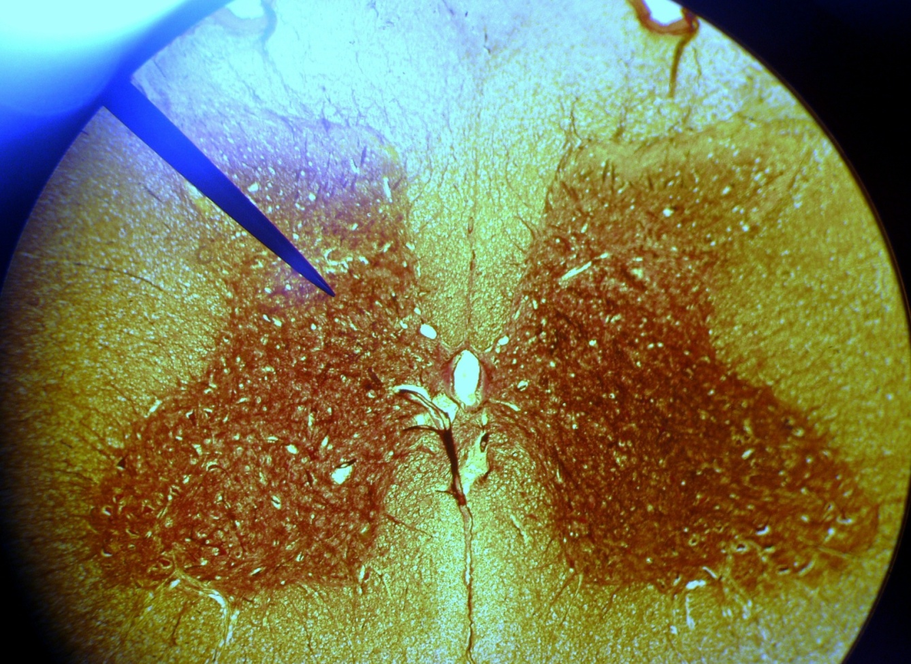
Spinal Cord Histology
Dorsal Funiculus
Dorsal Horn
Gray Commissure
Lateral Horn
Central Canal
Lateral Funiculus
Ventral Horn
Ventral Funiculus

Slide 11
Spinal Cord Histology

Slide 12
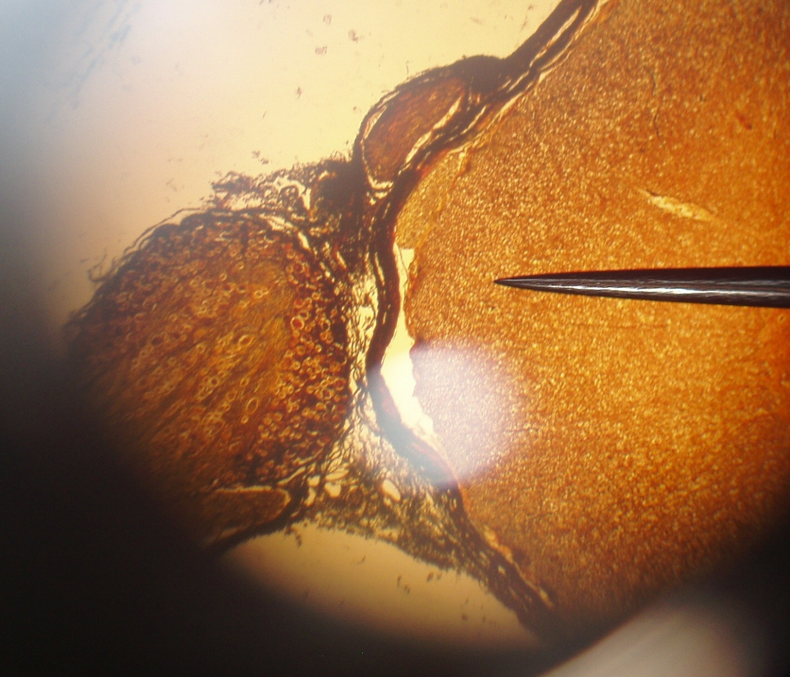
Dorsal Root
Dorsal Root Ganglion
Ventral Root

Slide 14
Spinal Cord Practice
Print out the following slides and practice labeling them!

